Slide 1
Outro To Parallel Computing
(also known as Part II, or A Lot About Software)
John Urbanic
Pittsburgh Supercomputing Center
September 11, 2008

Slide 2
Purpose of this talk
Now that you know how to do some real parallel programming, you may wonder how much you don’t know. With your newly informed perspective we will take a look at the parallel software landscape so that you can see how much of it you are equipped to traverse.

Slide 3
A quick outline…
An example
Scaling
Amdahl’s Law
Languages and Paradigms
  Message Passing
  Data Parallel
  Threads
  PGAS
  Hybrid
Data Decomposition
Load Balancing
Summary

Slide 4
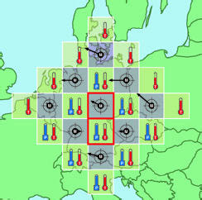
Richardson's Computation, 1917
Prototypical Example: Weather Modeling
Courtesy John Burkhardt, Virginia Tech

Slide 5
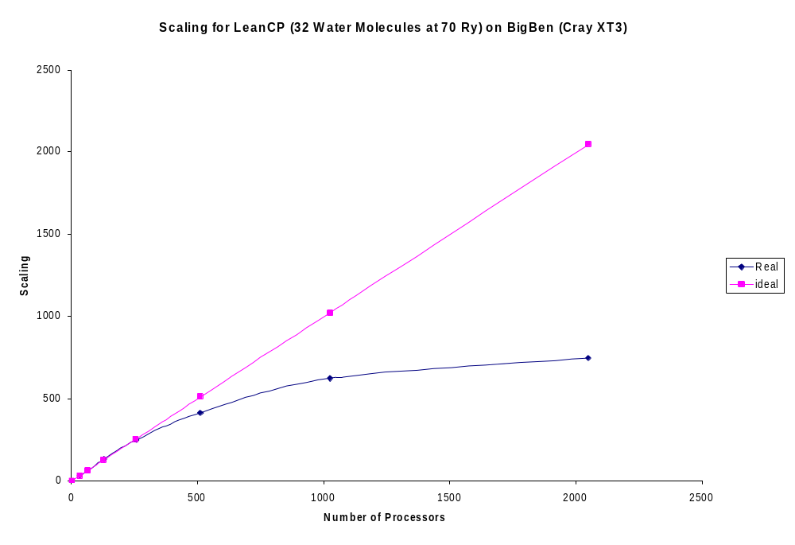
How parallel is a code?
Parallel performance is defined in terms of scalability
Strong Scalability
Can we get faster for a
Problem size?

Slide 6
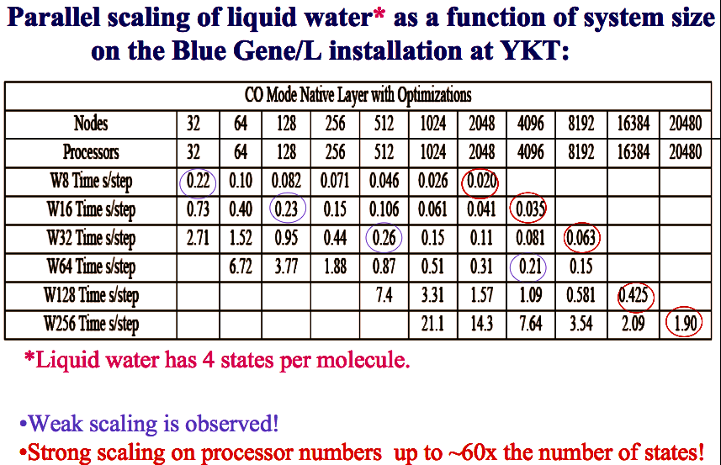
Weak vs. Strong scaling
Weak Scalability
How big of a problem can
we do?

Slide 7
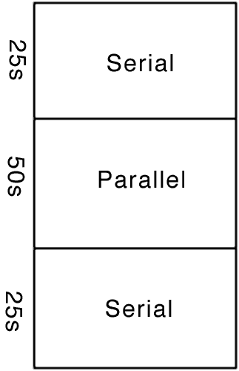
Your Scaling Enemy: Amdahl’s Law
How many processors can we really use?
Let’s say we have a legacy code such that is it only feasible to convert half of the heavily used routines to parallel:

Slide 8
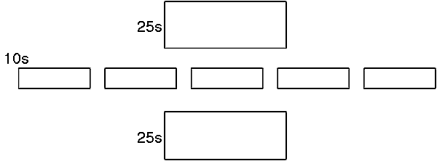
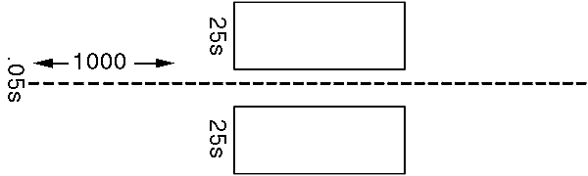
Amdahl’s Law
If we run this on a parallel machine with five processors:
Our code now takes about 60s. We have sped it up by about 40%.
Let’s say we use a thousand processors:
We have now sped our code by about a factor of two. Is this a big enough win?

Slide 9
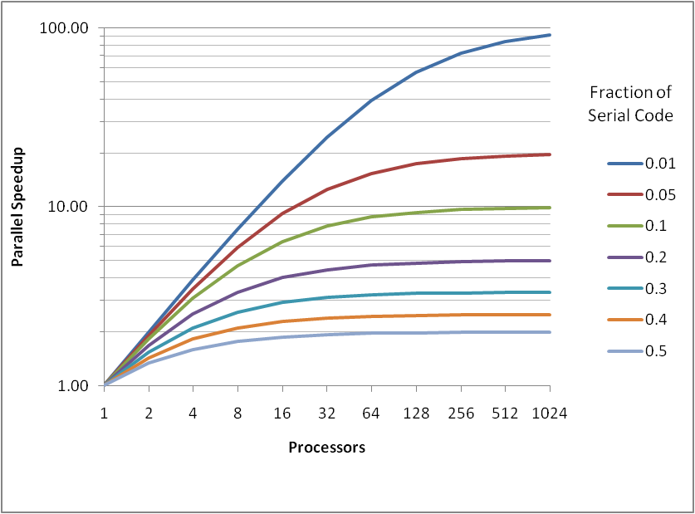
Amdahl’s Law
  If there is x% of serial component, speedup cannot be better than 100/x.
  If you decompose a problem
  into many parts, then the parallel
  time cannot be less than the
  largest of the parts.
  If the critical path through a
  computation is T, you cannot
  complete in less time than T,
  no matter how many processors you use .
Notes:
put in graph of amdahl’s law

Slide 10
Need to write some scalable code?
First Choice:
  Pick a language - or maybe a library, or paradigm (whatever that is)?

Slide 11
Languages: Pick One. (Hint: MPI)
Parallel Programming environments since the 90’s
ABCPL
ACE
ACT++
Active messages
Adl
Adsmith
ADDAP
AFAPI
ALWAN
AM
AMDC
AppLeS
Amoeba
ARTS
Athapascan-0b
Aurora
Automap
bb_threads
Blaze
BSP
BlockComm
C*.
"C* in C
C**
CarlOS
Cashmere
C4
CC++
Chu
Charlotte
Charm
Charm++
Cid
Cilk
CM-Fortran
Converse
Code
COOL
CORRELATE
CPS
CRL
CSP
Cthreads
CUMULVS
DAGGER
DAPPLE
Data Parallel C
DC++
DCE++
DDD
DICE.
DIPC
DOLIB
DOME
DOSMOS.
DRL
DSM-Threads
Ease .
ECO
Eiffel
Eilean
Emerald
EPL
Excalibur
Express
Falcon
Filaments
FM
FLASH
The FORCE
Fork
Fortran-M
FX
GA
GAMMA
Glenda
GLU
GUARD
HAsL.
Haskell
HPC++
JAVAR.
HORUS
HPC
IMPACT
ISIS.
JAVAR
JADE
Java RMI
javaPG
JavaSpace
JIDL
Joyce
Khoros
Karma
KOAN/Fortran-S
LAM
Lilac
Linda
JADA
WWWinda
ISETL-Linda
ParLin
Eilean
P4-Linda
Glenda
POSYBL
Objective-Linda
LiPS
Locust
Lparx
Lucid
Maisie
Manifold
Mentat
Legion
Meta Chaos
Midway
Millipede
CparPar
Mirage
MpC
MOSIX
Modula-P
Modula-2*
Multipol
MPI
MPC++
Munin
Nano-Threads
NESL
NetClasses++
Nexus
Nimrod
NOW
Objective Linda
Occam
Omega
OpenMP
Orca
OOF90
P++
P3L
p4-Linda
Pablo
PADE
PADRE
Panda
Papers
AFAPI.
Para++
Paradigm
Parafrase2
Paralation
Parallel-C++
Parallaxis
ParC
ParLib++
ParLin
Parmacs
Parti
pC
pC++
PCN
PCP:
PH
PEACE
PCU
PET
PETSc
PENNY
Phosphorus
POET.
Polaris
POOMA
POOL-T
PRESTO
P-RIO
Prospero
Proteus
QPC++
PVM
PSI
PSDM
Quake
Quark
Quick Threads
Sage++
SCANDAL
SAM
pC++
SCHEDULE
SciTL
POET
SDDA.
SHMEM
SIMPLE
Sina
SISAL.
distributed smalltalk
SMI.
SONiC
Split-C.
SR
Sthreads
Strand.
SUIF.
Synergy
Telegrphos
SuperPascal
TCGMSG.
Threads.h++.
TreadMarks
TRAPPER
uC++
UNITY
UC
V
ViC*
Visifold V-NUS
VPE
Win32 threads
WinPar
WWWinda
XENOOPS
XPC
Zounds
ZPL
Challenge to language designers … These were smart people. Why will you succeed where they failed?
Notes:
Lets look at the history of supercomputing and see if we can get some clues about what we should do.
Back in the late 80’s and early 90’s, we thought all the ISV’s needed to enter parallel computing was a portable Application programming interface. So the universities and a number of small companies (3 of them – 2 of which I used to work for) came up with all sorts of API’s.
It is my firm belief that this backfired on us. The fact there were so many API’s made parallel computing computer scientists look stupid. If we couldn’t agree on an effective approach to parallel computing, how could we expect non-specialist ISV’s to figure this out.

Slide 12
Paradigm?
Message Passing
Data Parallel
Threads
PGAS
Hybrid

Slide 13
Message Passing
Pros
  Flexible
    Can do almost any other “paradigm” with this as a layer
    Used by many of the other paradigms and layers underneath
    Can implement very efficient load balancing and domain decomposition
  Efficient
    Ultimately, this is what the machine does over its network anyway
    Often the network hardware API is simply a MP library
  Implementations Solid
    There are several widely know implementations
      MPI
      Portals
      Remote Memory Access/Shmem
  Algorithmic Support
    Much research has been done in solving problems using MP
  Debugging Support
    Both debuggers and techniques have been developed
Cons
  Lower level means more detail for the coder
  Debugging requires more attention to detail
  Development usually requires a “start from scratch” approach
  Domain decomposition and memory management must be explicit

Slide 14
Why Use MPI in particular?
Has been around a longtime (~20 years inc. PVM)
Dominant
Will be around a longtime (on all new platforms/roadmaps)
Lots of libraries
Lots of algorithms
Very scalable (100K+ cores right now)
Portable
Works with hybrid models

Slide 15
Remote Memory Access
A type of message passing that implements one-sided puts and gets
into and out of remote memory locations. Very efficient, and often
elegant in simplicity. Some versions are:
MPI-2 (parts)
Shmem
Portals
ARMCI
In most cases, you can transition to or from one of these and MPI
without rewriting your algorithm.

Slide 16
Data Parallel
Only one executable.
Do computation on arrays of data using array operators.
Do communications using array shift or rearrangement operators.
Good for problems with static load balancing that are array-oriented SIMD machines.
Variants:
FORTRAN 90
CM FORTRAN
HPF
C*
GPU Langauges (CUDA)
Strengths:
Scales transparently to different size machines
Easy debugging, as there I sonly one copy of code executing in highly synchronized fashion
Weaknesses:
Much wasted synchronization
Difficult to balance load

Slide 17
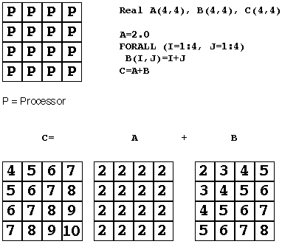
Data Parallel – Fortran90
Computation in FORTRAN 90

Slide 18
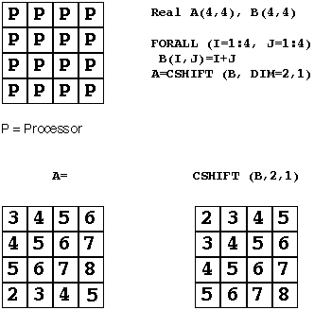
Data Parallel
Communication in FORTRAN 90

Slide 19
Data Parallel
When to use Data Parallel
  Very regular grid oriented programs
    Some FEA
    Some Fluid Dynamics
    Neural Nets
  Very synchronized operations
    Image processing
    Math analysis

Slide 20
Threads
Splits up tasks (as opposed to arrays in data parallel) such as loops amongst separate processors.
Do communication as a side effect of data loop distribution. Not an big issue on shared memory machines. Impossible on distributed memory.
Common Implementations:
pthreads (Unix standard)
OpenMP
Strengths:
Doesn’t perturb data structures, so can be incrementally added to existing serial codes.
Weaknesses:
Serial code left behind will be hit by Amdahl’s Law
Forget about taking this to the next level of scalability. You can not do this on MPPs at the machine wide level.

Slide 21
Pros of OpenMP in particular
Just add it incrementally to existing code
Standard and widely available (supported at compiler level)
  gcc
  Intel
  PGI
  IBM
Compiler directives are generally simple and easy to use than thread API’s

Slide 22
Cons of OpenMP
In general, only moderate speedups can be achieved.
  Because OpenMP codes tend to have serial-only portions, Amdahl’s Law prohibits substantial speedups
  Can only be run in shared memory environments
  Will have issues with NUMA
Notes:
put in graph of amdahl’s law

Slide 23
Partitioned Global Address Space: (PGAS)
Multiple threads share at least a part of a global address space.
Can access local and remote data with same mechanisms.
Can distinguish between local and remote data with some sort of typing.
Variants:
Co-Array Fortran (CAF)
Unified Parallel C (UPC)
Strengths:
Looks like SMP on a distributed memory machine.
Currently translates code into an underlying message passing version for efficiency.
Weaknesses:
Depends on (2) to be efficient.
Can easily write lots of expensive remote memory access without paying attention.
Currently immature.

Slide 24
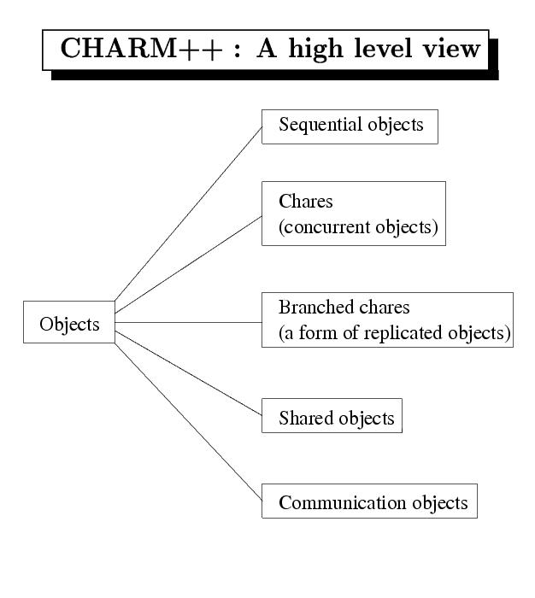
Frameworks
One of the more experimental approaches that is gaining some traction is to use a parallel framework that handles the load balancing and messaging while you “fill in” the science. Charm++ is a particularly popular example:
Charm++
  Object-oriented parallel extension to C++
  Run-time engine allows work to be “scheduled” on the computer.
  Highly-dynamic, extreme load-balancing capabilities.
  Completely asynchronous.
  NAMD, a very popular MD simulation engine is written in Charm++

Slide 25
Hybrid Coding
Problem: given the engineering constraint of a machine made up of a large collection of multi-core processors, how do we use message passing at the wide level while still taking advantage of the local shared memory?
Solution (at least one): Hybrid Coding.
As the most useful MP library is MPI, and the most useful SM library is OpenMP, the obvious mix is MPI and OpenMP.
But, one must design the MPI layer first, and them apply the OpenMP code at the node level. The reverse is rarely a viable option.

Slide 26
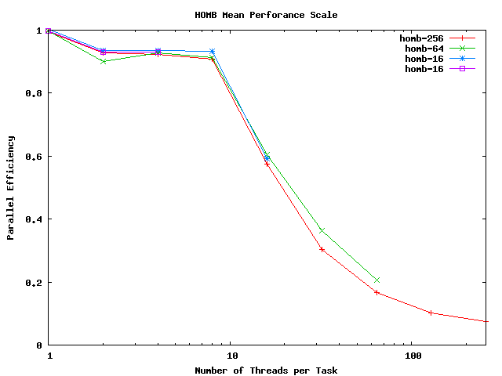
Hybrid Expectations
NUMA (or SMP node size) will impose a wall on the OpenMP border. From your class example:
Courtesy of Maxwell Hutchinson

Slide 27
Hybrid OpenMP Regime

Slide 28
Good Hybrid Application
Code with a large lookup table, like an Equation of State table. Global variables are always evil, but we really need this large data structure accessible to every node.
T = 100, S = 200
T = 101, S = 201
T = 102, S = 204
T = 103, S = 199
T = 104, S = 198
T = 105, S = 197
T = 100, S = 200
T = 101, S = 201
T = 102, S = 204
T = 103, S = 199
T = 104, S = 198
T = 105, S = 197

Slide 29
Good Hybrid Application
If we use straight MPI, then we end up duplicating this table on every PE.
T = 100, S = 200
T = 101, S = 201
T = 102, S = 204
T = 103, S = 199
T = 104, S = 198
T = 105, S = 197
T = 100, S = 200
T = 101, S = 201
T = 102, S = 204
T = 100, S = 200
T = 101, S = 201
T = 102, S = 204
T = 103, S = 199
T = 104, S = 198
T = 105, S = 197
T = 100, S = 200
T = 101, S = 201
T = 102, S = 204
T = 100, S = 200
T = 101, S = 201
T = 102, S = 204
T = 103, S = 199
T = 104, S = 198
T = 105, S = 197
T = 100, S = 200
T = 101, S = 201
T = 102, S = 204
T = 100, S = 200
T = 101, S = 201
T = 102, S = 204
T = 103, S = 199
T = 104, S = 198
T = 105, S = 197
T = 100, S = 200
T = 101, S = 201
T = 102, S = 204
T = 100, S = 200
T = 101, S = 201
T = 102, S = 204
T = 103, S = 199
T = 104, S = 198
T = 105, S = 197
T = 100, S = 200
T = 101, S = 201
T = 102, S = 204
T = 100, S = 200
T = 101, S = 201
T = 102, S = 204
T = 103, S = 199
T = 104, S = 198
T = 105, S = 197
T = 100, S = 200
T = 101, S = 201
T = 102, S = 204
T = 100, S = 200
T = 101, S = 201
T = 102, S = 204
T = 103, S = 199
T = 104, S = 198
T = 105, S = 197
T = 100, S = 200
T = 101, S = 201
T = 102, S = 204
T = 100, S = 200
T = 101, S = 201
T = 102, S = 204
T = 103, S = 199
T = 104, S = 198
T = 105, S = 197
T = 100, S = 200
T = 101, S = 201
T = 102, S = 204

Slide 30
Good Hybrid Application
With a hybrid approach, we can reduce this to one copy per node. A big win if the table size is significant.
T = 100, S = 200
T = 101, S = 201
T = 102, S = 204
T = 103, S = 199
T = 104, S = 198
T = 105, S = 197
T = 100, S = 200
T = 101, S = 201
T = 102, S = 204
T = 100, S = 200
T = 101, S = 201
T = 102, S = 204
T = 103, S = 199
T = 104, S = 198
T = 105, S = 197
T = 100, S = 200
T = 101, S = 201
T = 102, S = 204
Case of 4 cores(PEs) per node.

Slide 31
Parallel Programming in a Nutshell
Assuming you just took our workshop
You have to spread something out.
These can theoretically be many types of abstractions: work, threads, tasks, processes, data,…
But what they will be is your data. And then you will use MPI, and possibly OpenMP, to operate on that data.

Slide 32
First (and only tricky) task:
Domain Decomposition
Everything will succeed or fail based on this step
It should seem natural, and often nature indeed shows the way

Slide 33
Domain Decomposition Done Well: Load Balanced
A parallel algorithm can only be as fast as the slowest chunk.
  Balance the number crunching
  Might be dynamic
Communication will take time
  Usually orders of magnitude difference between registers, cache, memory, network/remote memory, disk
  Data locality and “neighborly-ness” matters very much.

Slide 34
A Few Parting Coding Hints
Minimize Eliminate serial sections of code
  Only Way To Beat Amdahl’s law
Minimize communication overhead
  Choose algorithms that emphasize nearest neighbor communication
  Possibly Overlap computation and communication with asynchronous communication models
Dynamic load balancing (at least be aware of issue)
Minimize I/O and learn how to use parallel I/O
  Very expensive time wise, so use sparingly (and always binary)
Choose the right language for the job!
Plan out your code beforehand.
  Because the above won’t just happen late in development
  Transforming a serial code to parallel is rarely the best strategy

Slide 35
Summary (of entire workshop, really)
  Still mostly up to you if you want to scale beyond a few processors
    Automatic parallelization has been “a few years away” for the past 20 years.
  Dozens of choices
    But really only MPI (with maybe OpenMP)

Slide 36
Closing Note
  Your grant on this machine will allow you to continue with your learning and even do some development or porting, but it will run out in the next few weeks.
  You can easily get more time (albeit modest amounts to start) by requesting a grant at:
  http://www.psc.edu/work_with_us.php
  If you find this process the least inconvenient, you have an open invitation from Tom Maiden to contact him for help:
  tmaiden@psc.edu

